Slide 1
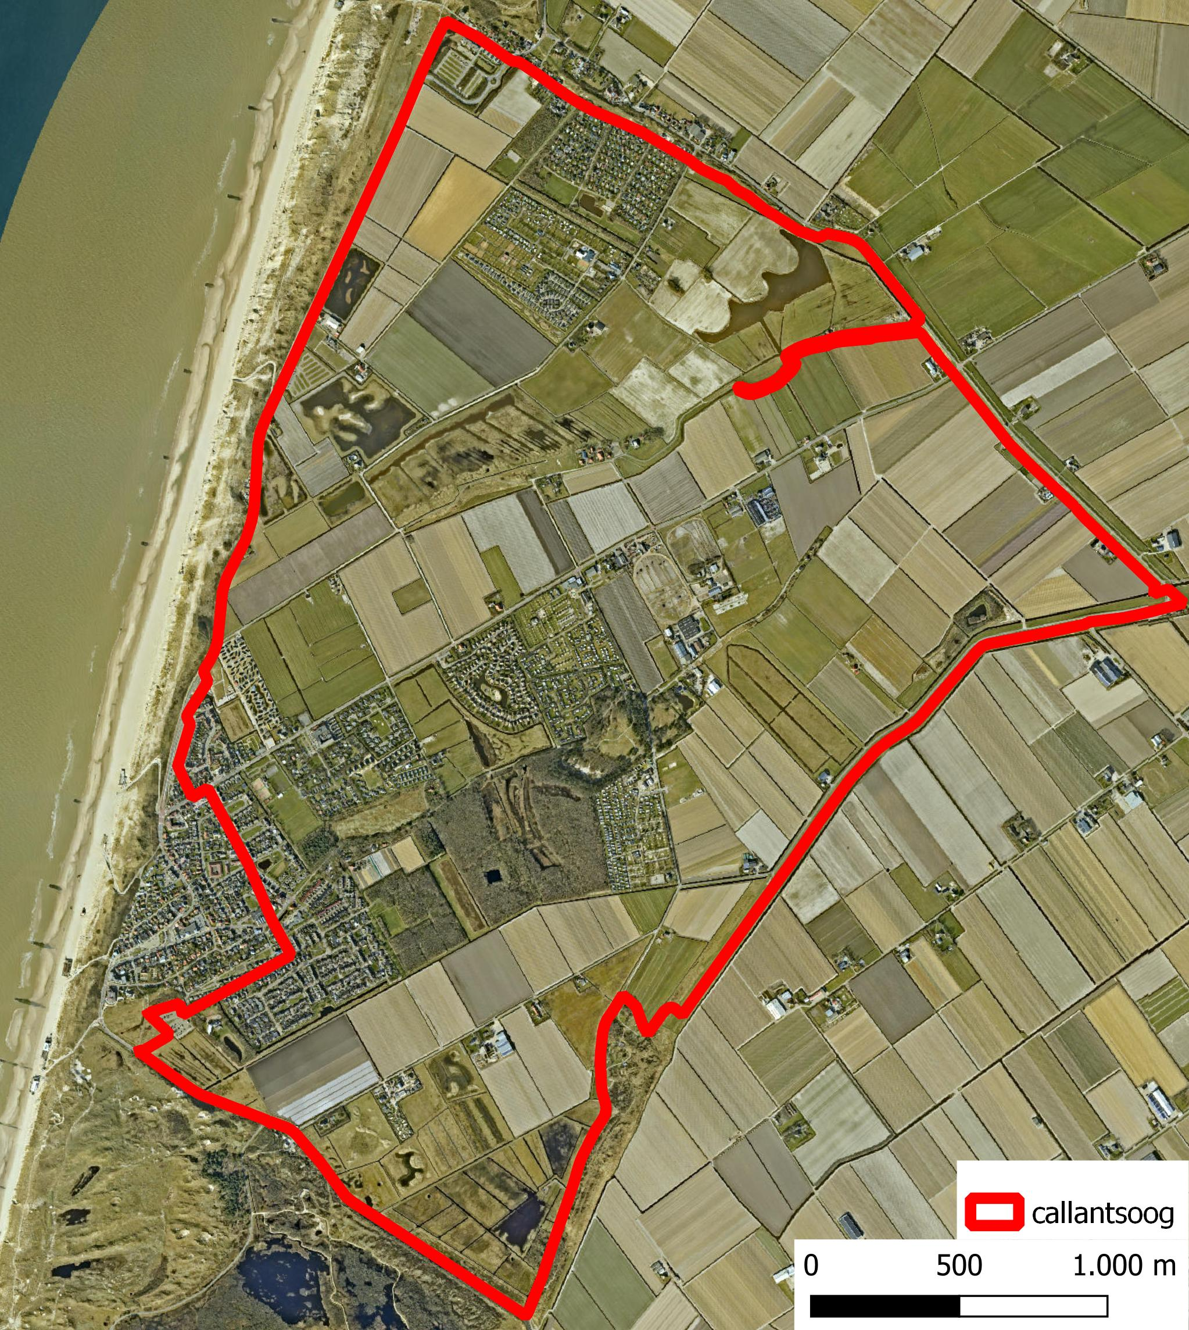
Group 5
Callantsoog
Anne Versleijen – 4542983
Christine Martin – 5603463
David Haasnoot – 4897900
Dwiva Anbiya Taruna – 5849578
Thomas Poort – 4715500

Slide 2
Main Goal
Design a realistic, robust, simplified and controllable system for Callantsoog.
How?
Robust for the coming century
Extra water storage north of the polder
Simplified & Controllable
Reduce the number of water decree levels from 31 to 7

Slide 3
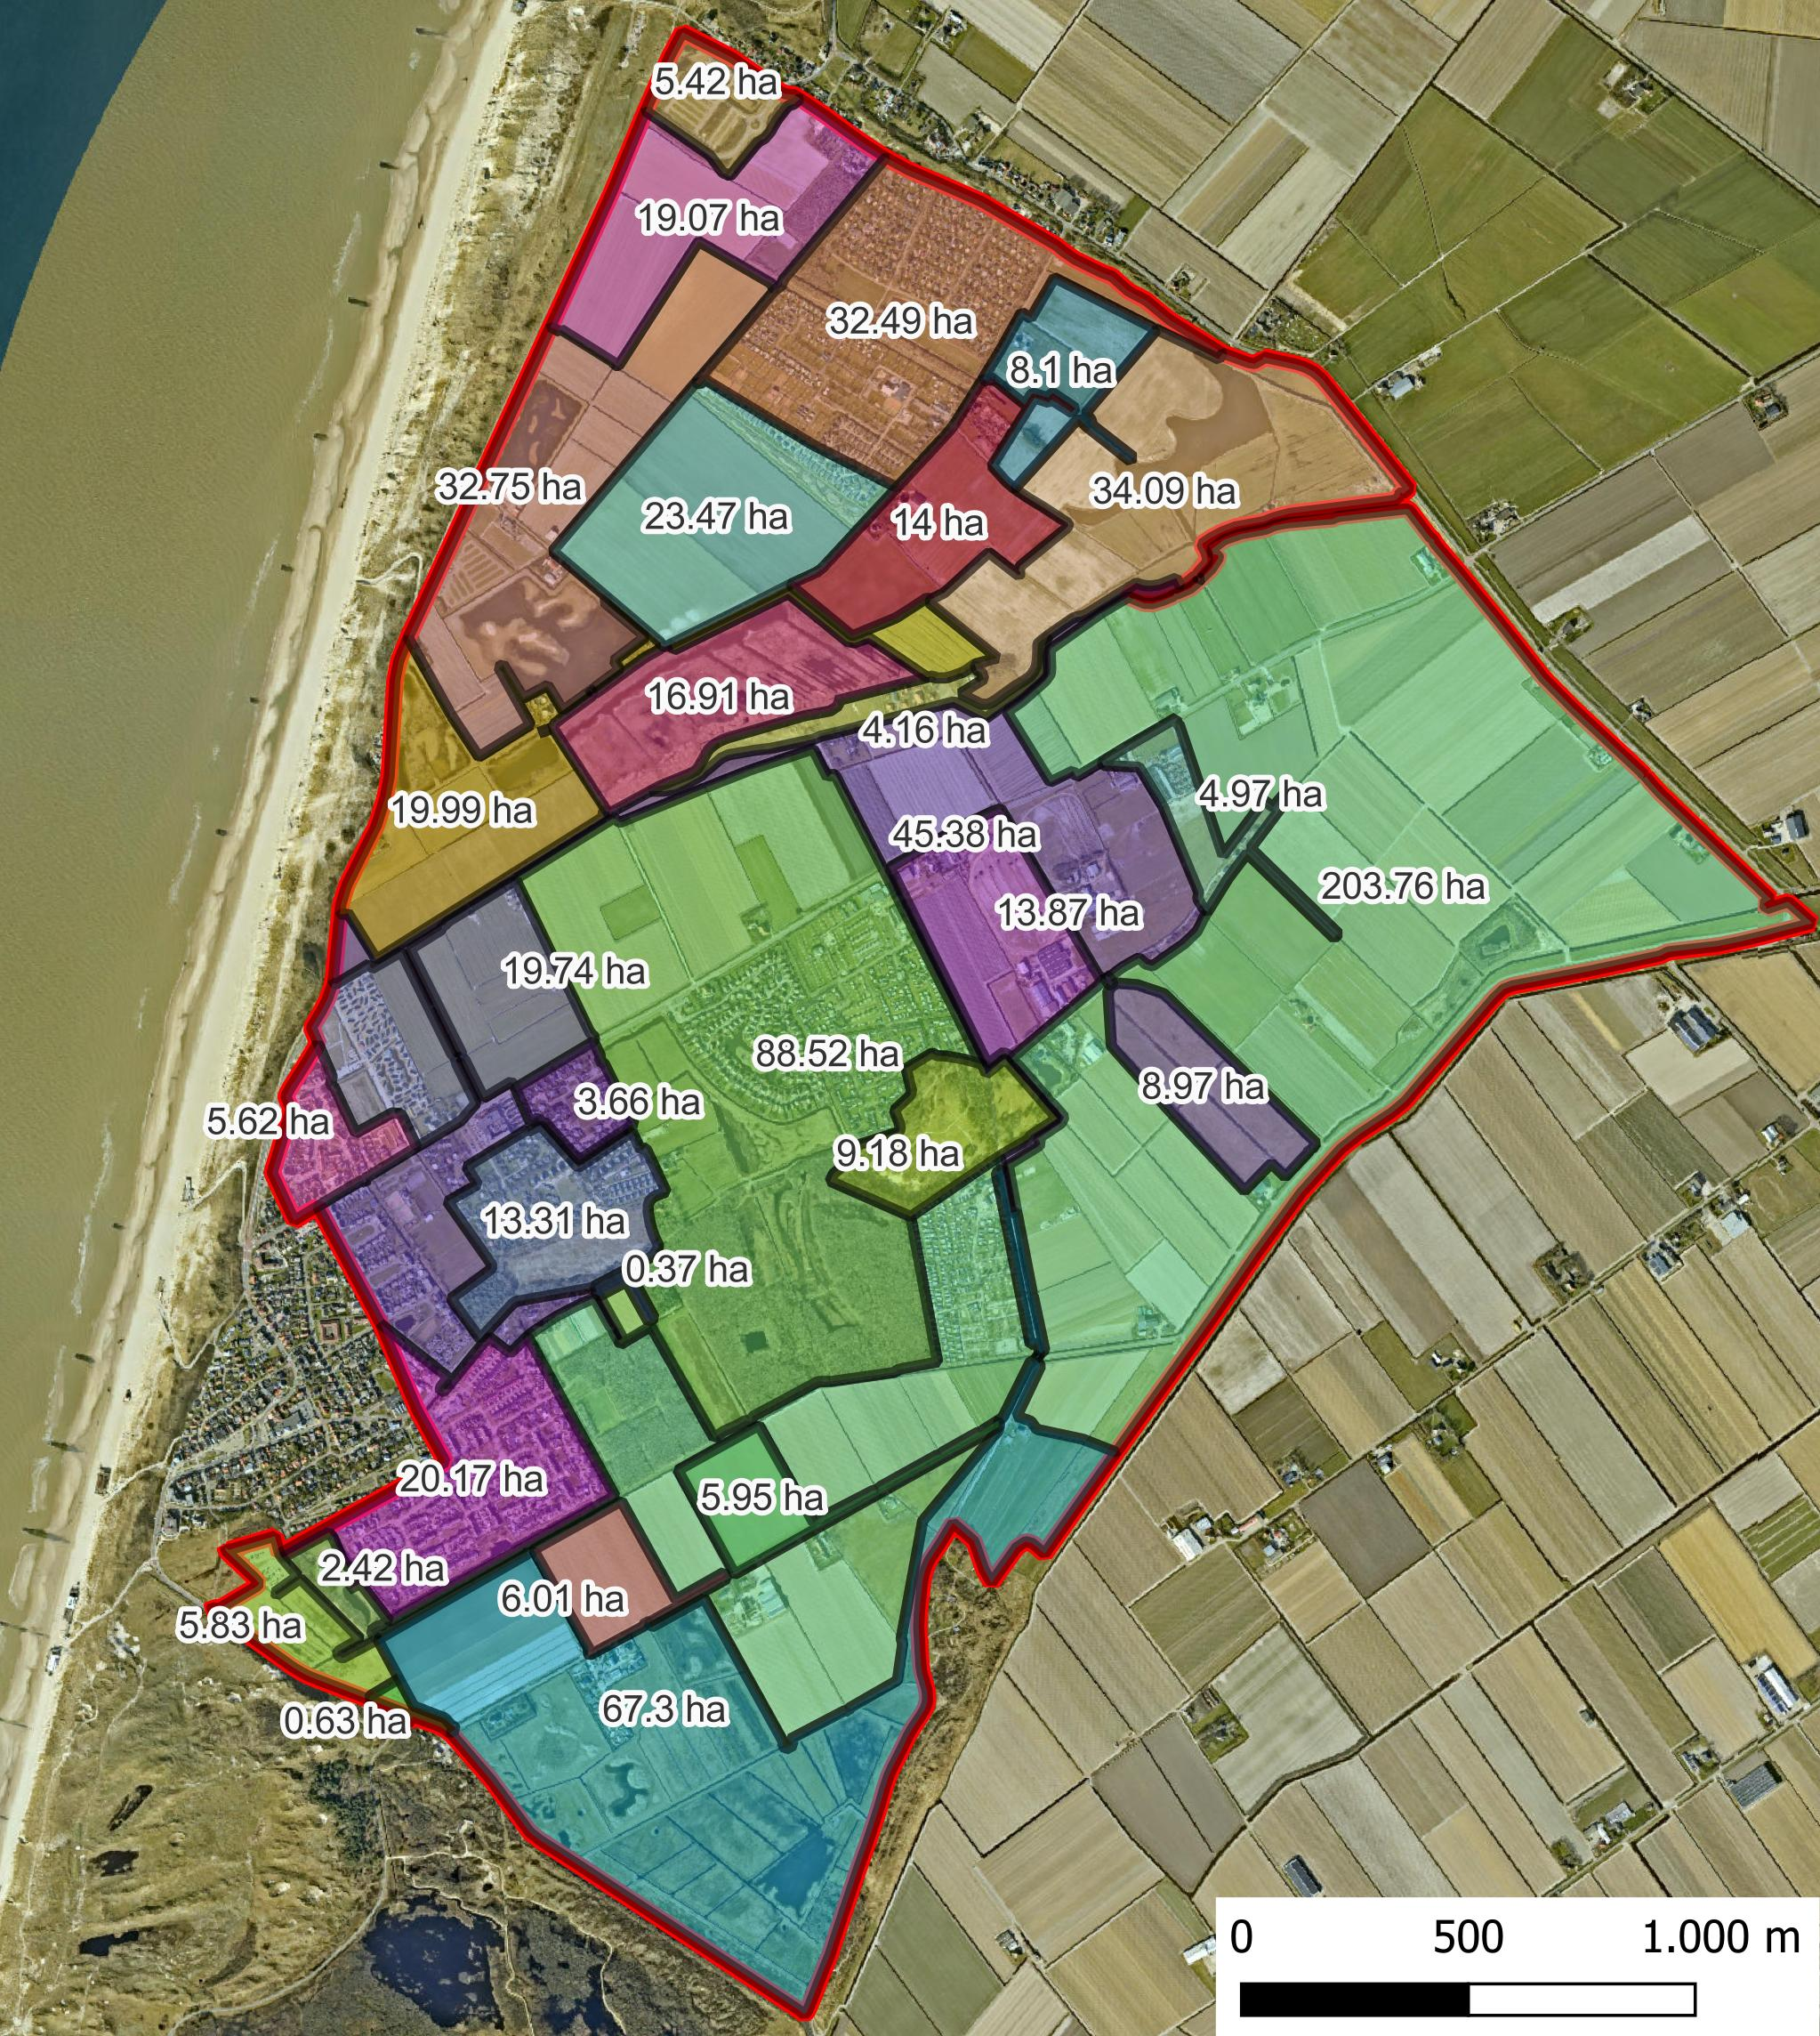
Water decree level
Current System

Slide 4
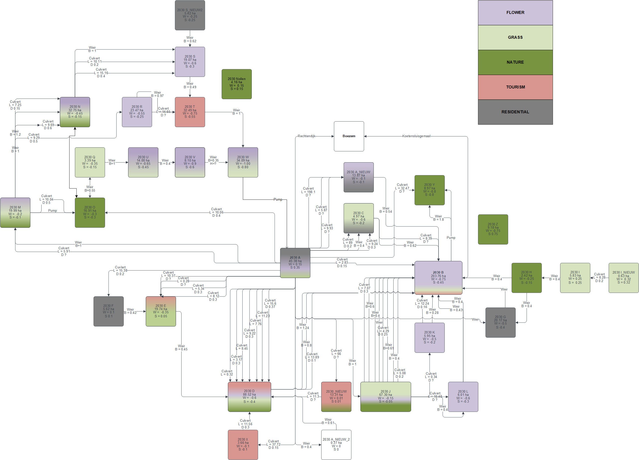
Water decree level
Current System

Slide 5
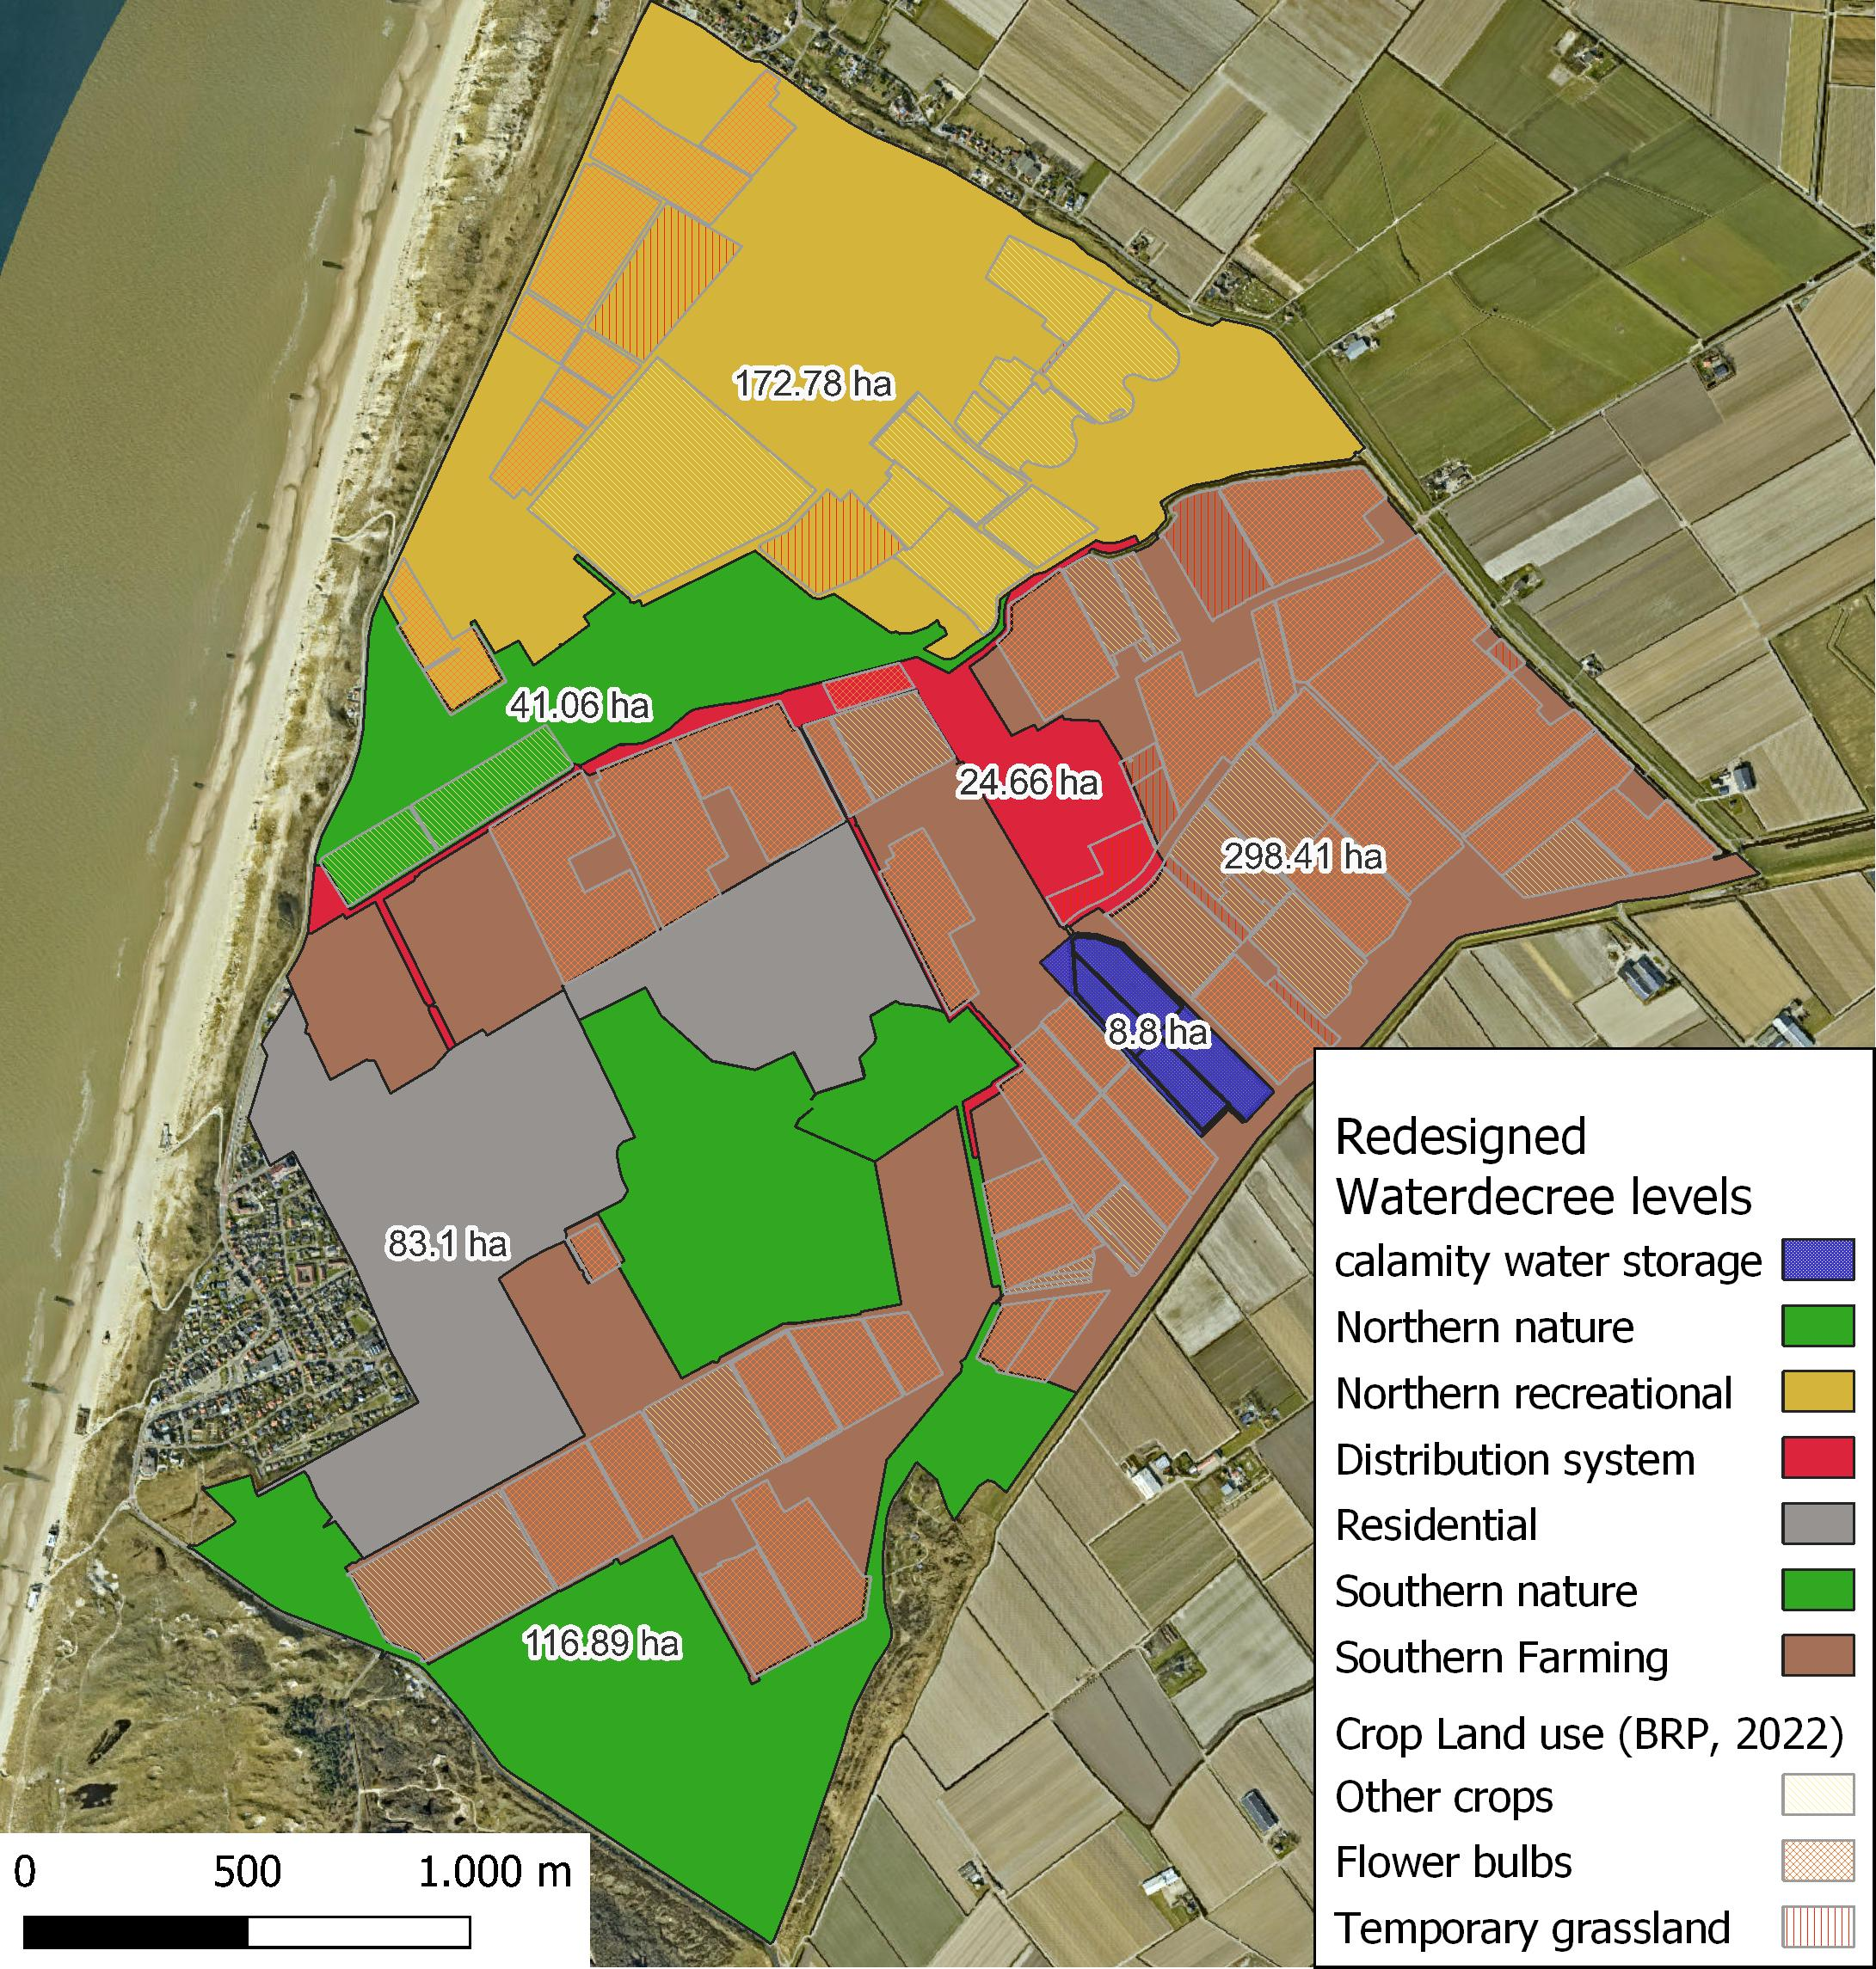
Water decree level
Proposed System

Slide 6
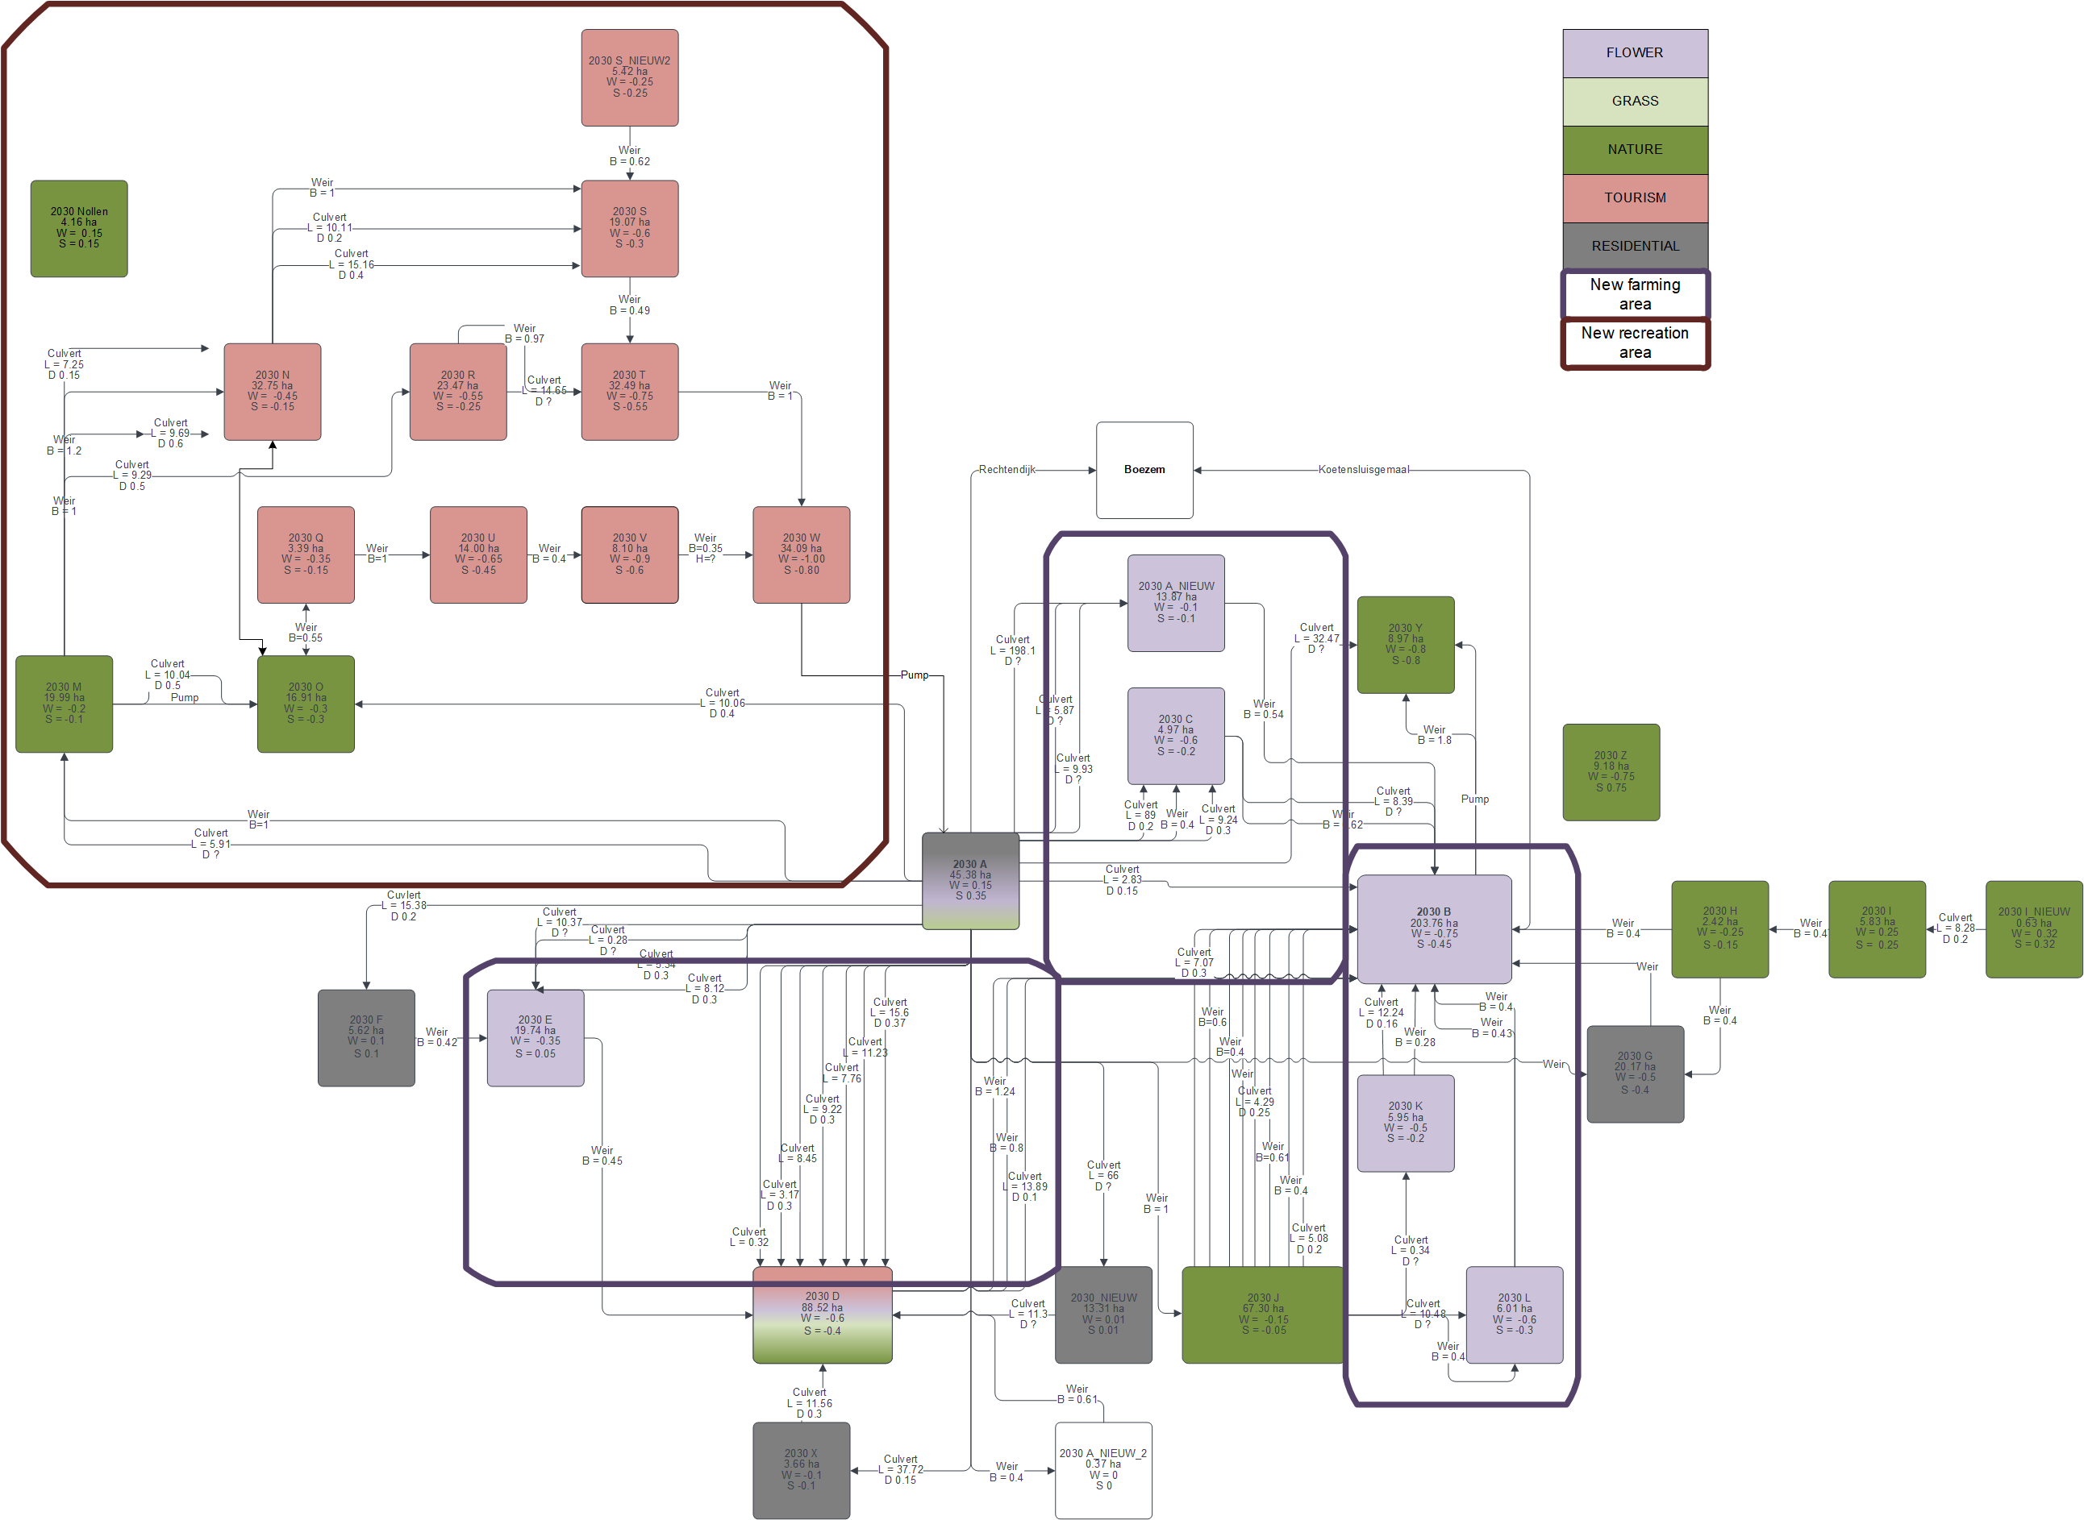
Water decree level
Proposed System

Slide 7
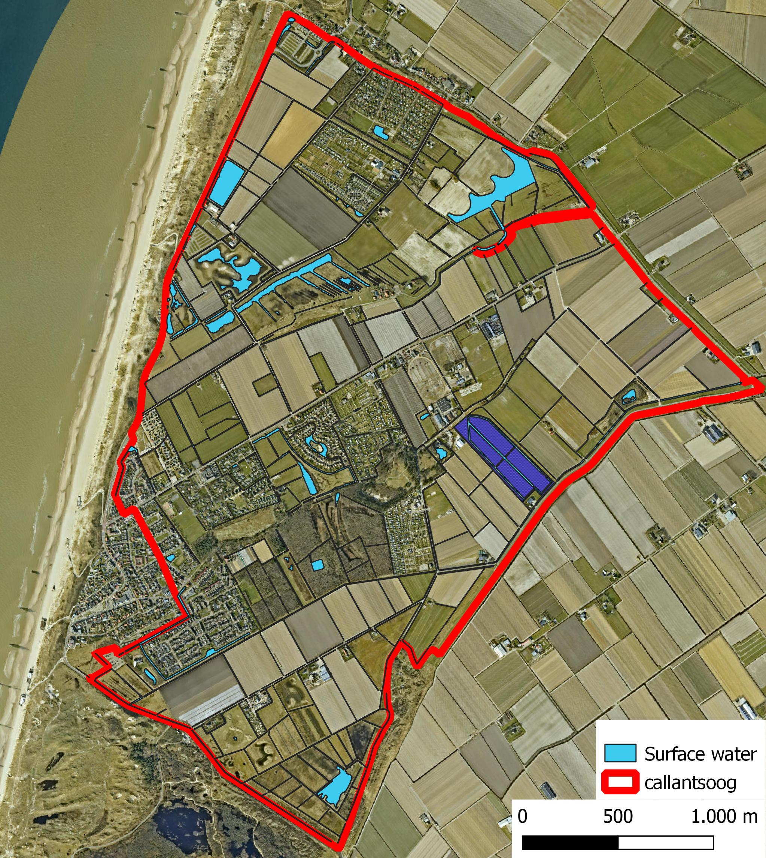
Surface water areas
Current System

Slide 8
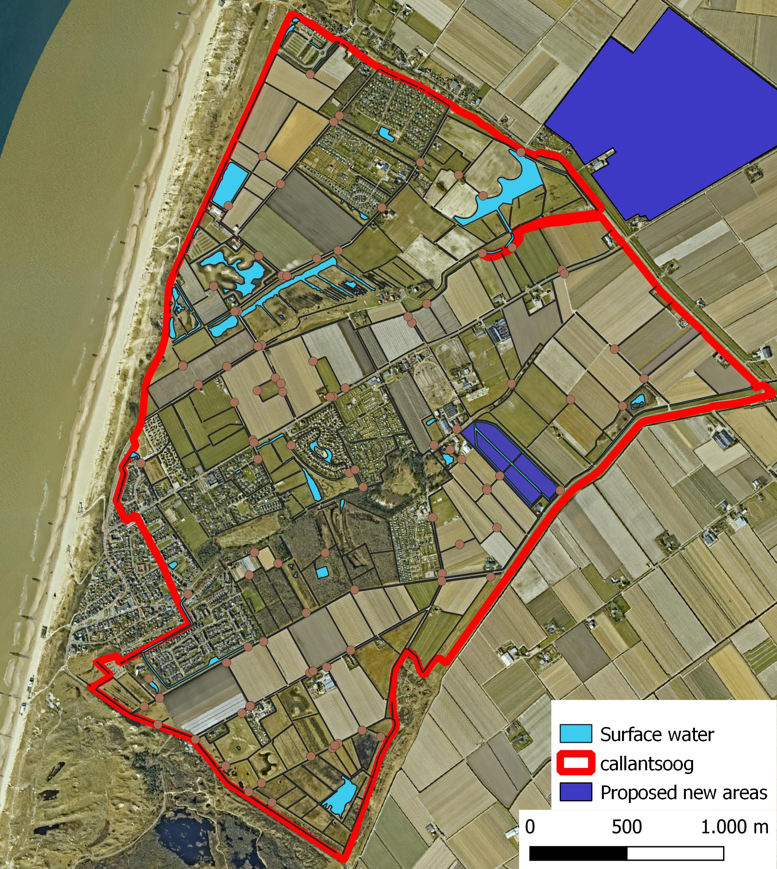
Surface water areas
Proposed new area

Slide 9
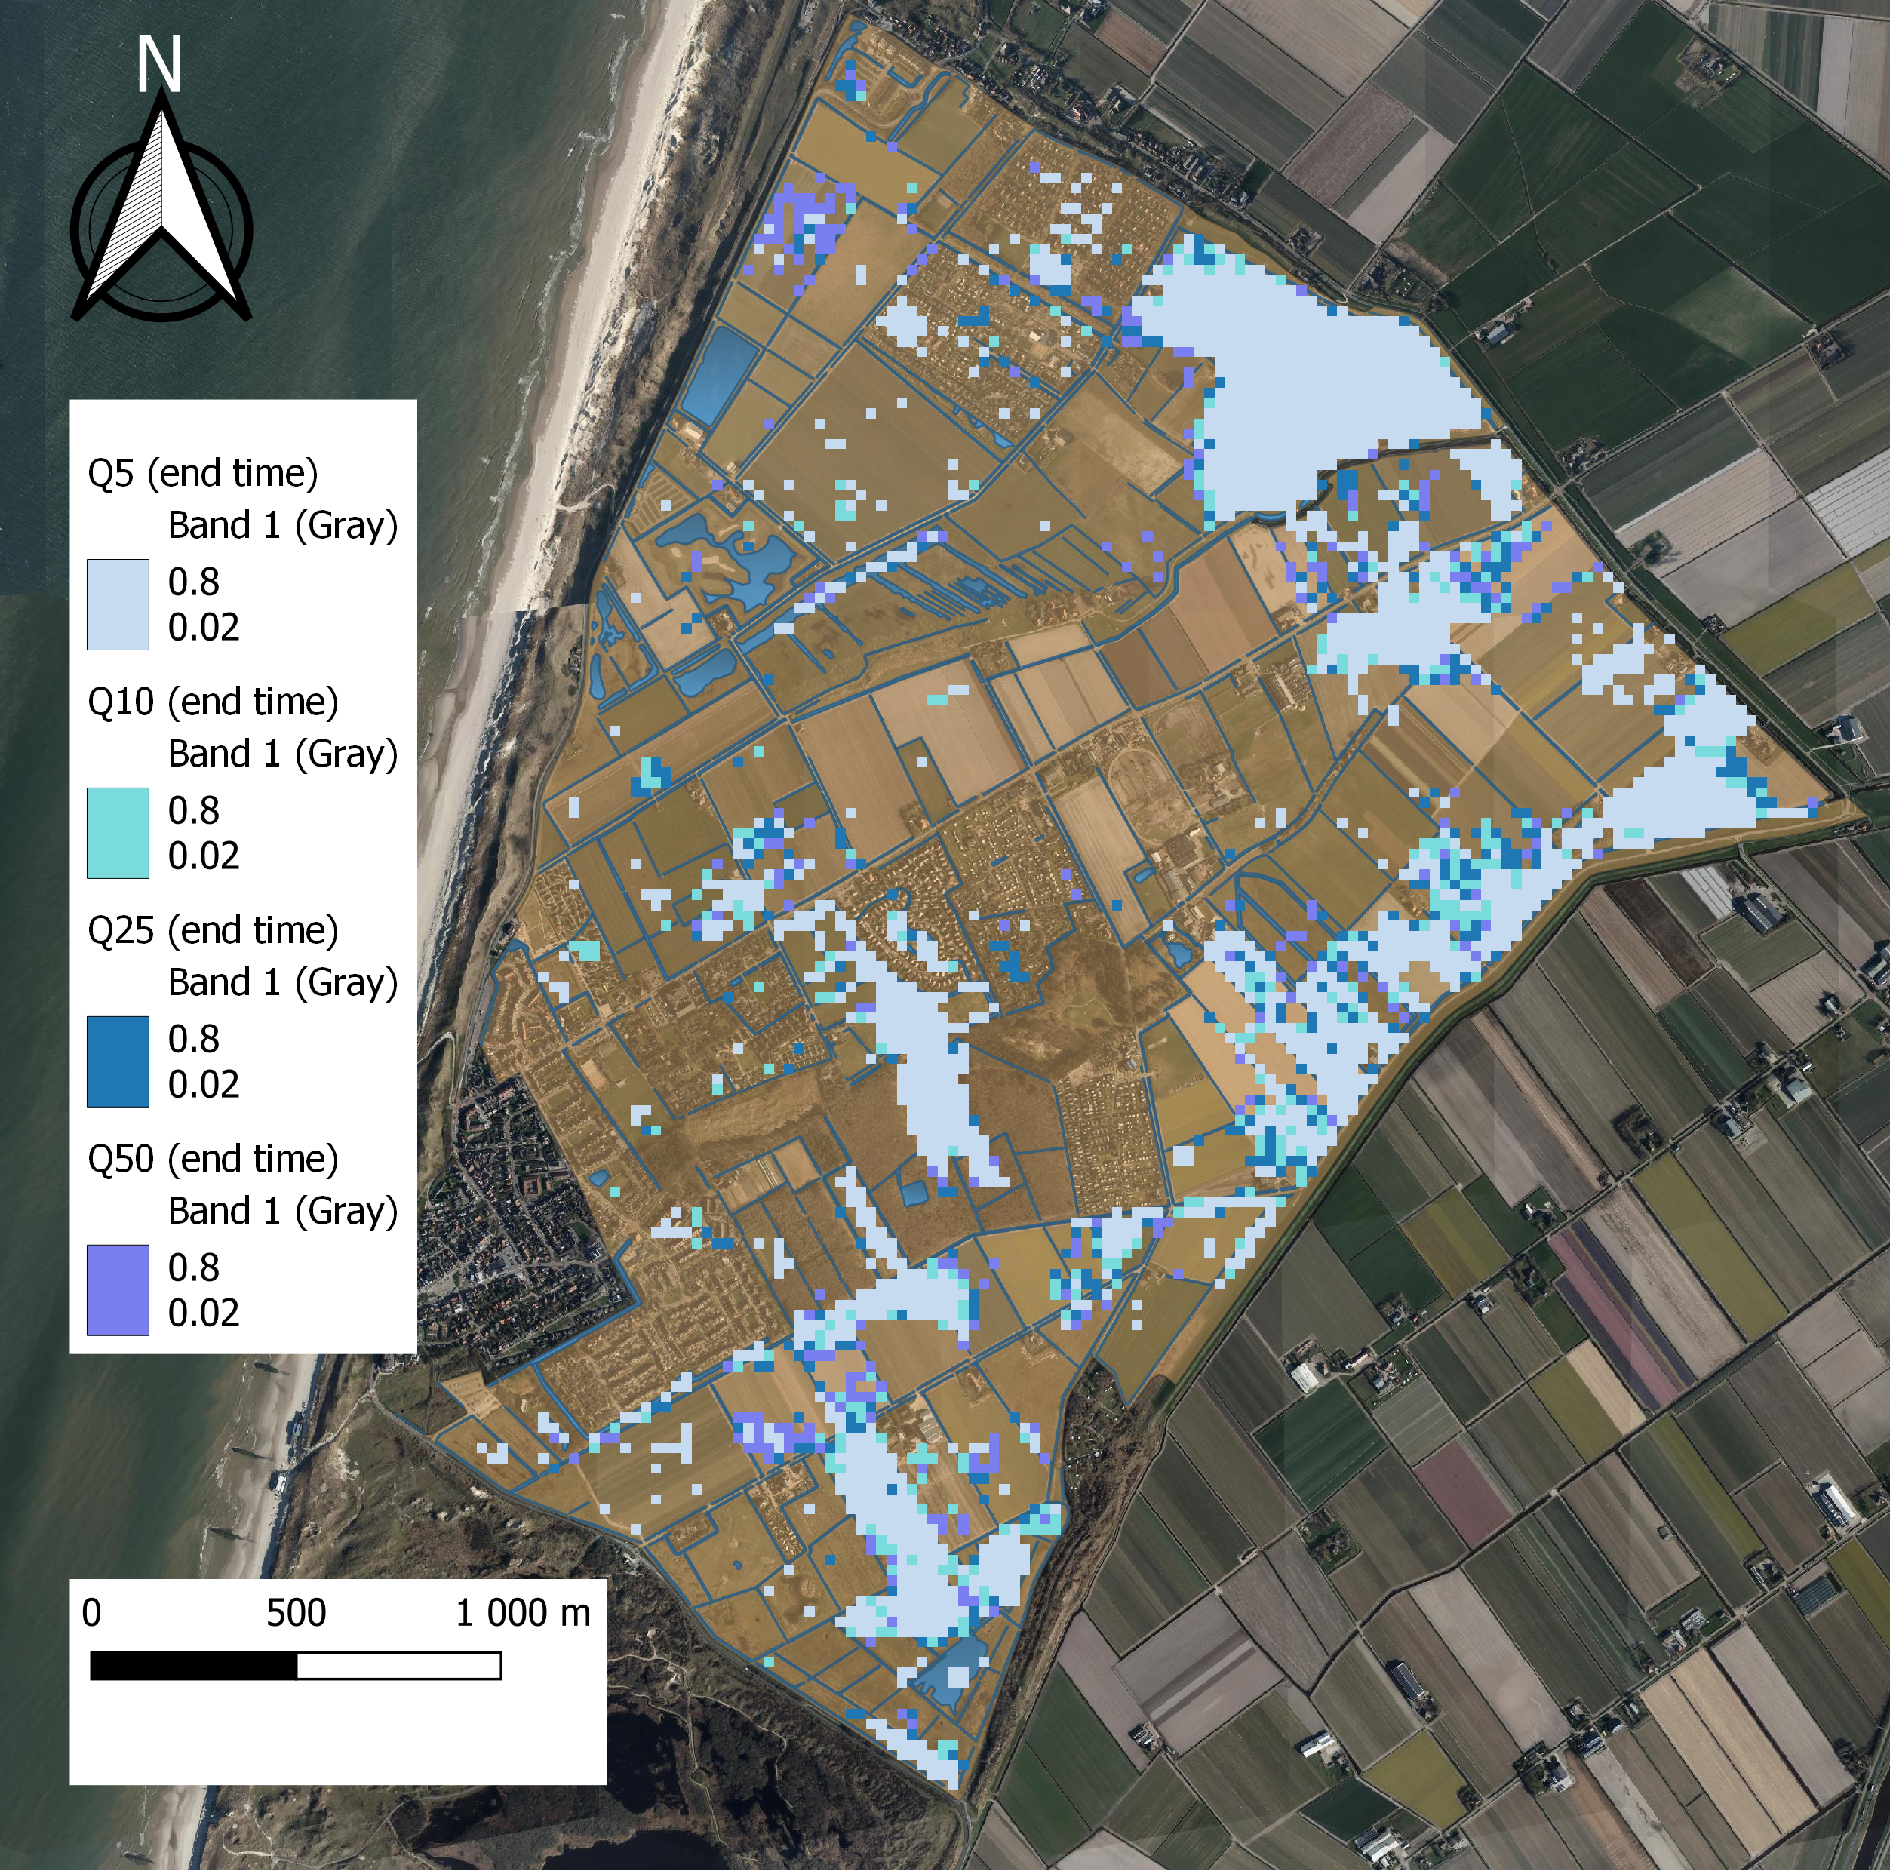
Hydraulic System
Current System

Slide 10
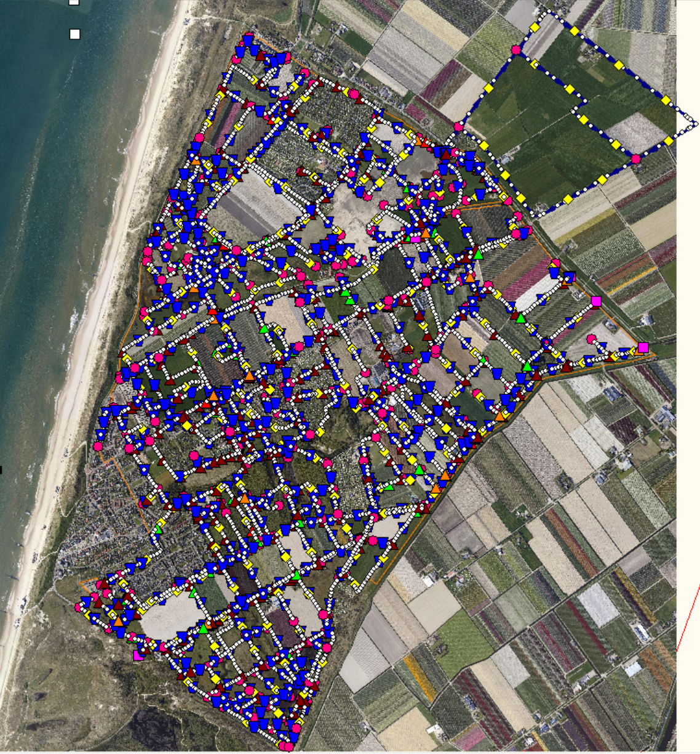
Hydraulic System
Proposed System

Slide 11
Stakeholders
Water board (client)
Impact: current system simplified, reduced risk of damaging floods in the future
Actions: implement new distribution system while maintaining relationship with farmers (and other stakeholders)
Farmers
Impact: 75.83 hectares in NW region no longer receives desired water levels, reduction of flooding and subsequent damage to crops
Actions: continue regulating own water levels, adjust farming practices, land use change (leasing, selling, relocation)
Any adopted plan should be implemented in cooperation with farmers (and other residents of Callantsoog) to better predict/prepare for impacts of and reactions to the system change.

Slide 12
Strategies to develop solution
New water decree levels:
Decide on feasible levels to test
Run SOBEK simulation with these new levels
Check new water decree is feasible for land use -> Make groundwater model
New water storage areas:
Incorporate into the SOBEK model

Slide 13
Thank you for your attention
Group 5

